Slide 1
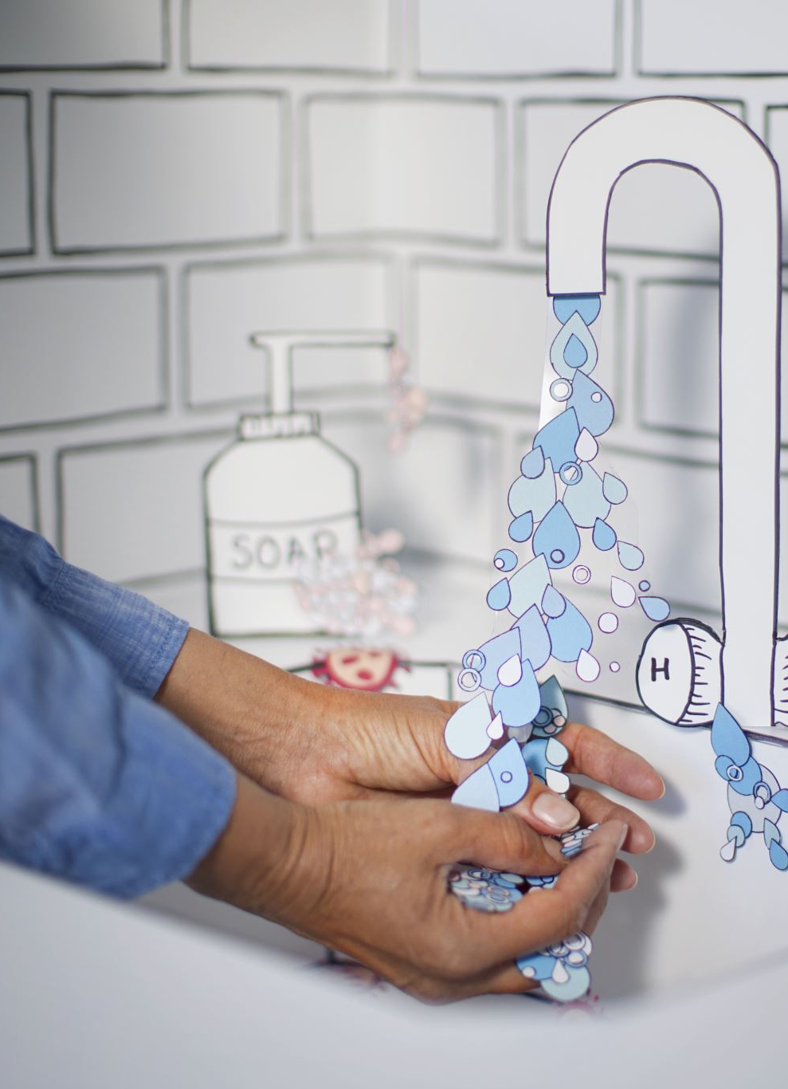
IF YOU SNEEZE WASH, PLEASE
Kevin Holmes​

Slide 2
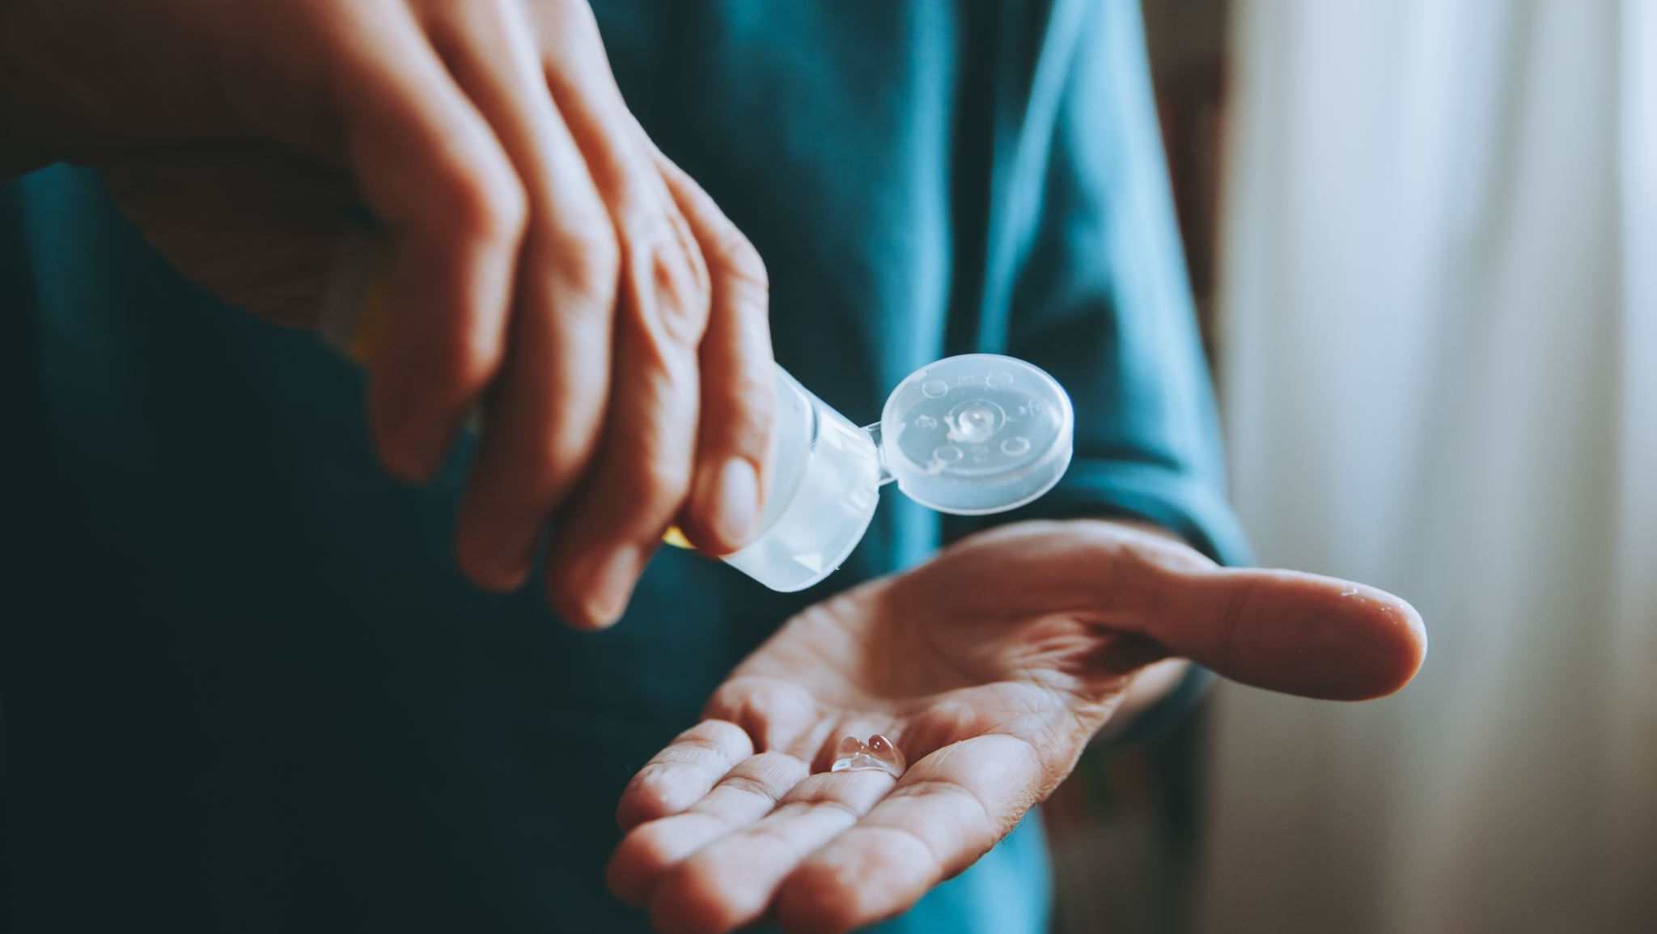
AGENDA Show The Importance Of Hand Washing

Slide 3
Cold and Pneumonia

Slide 4
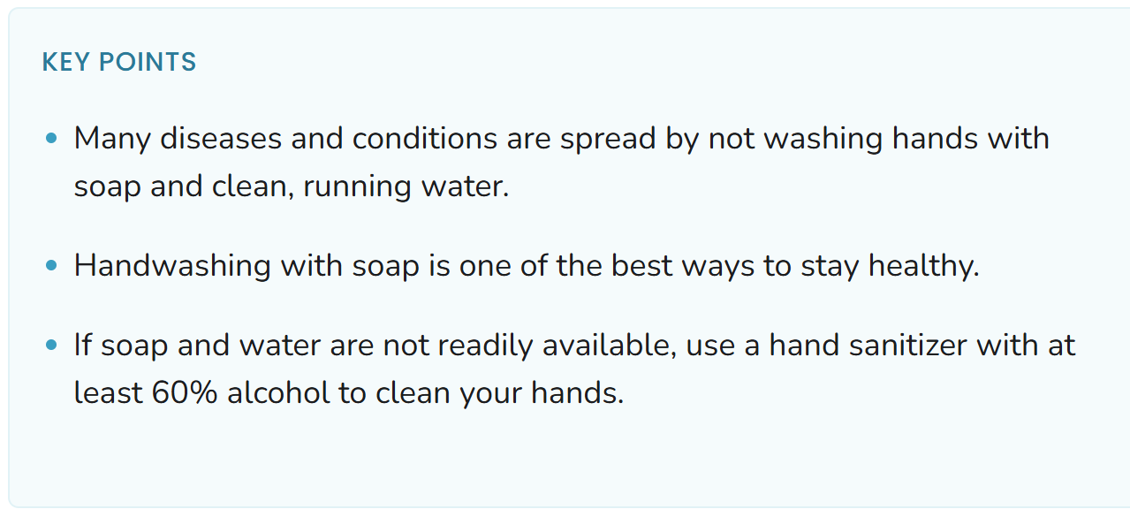
Say Your ABC’s Twice

Slide 5


THANK YOU

